Slide 2
Information about academic activities in single platform
Submitted to:
Department of Computer Science and Engineering

Slide 3
Supervised by: Prof. Priyanka jangde
Team Members
1. Ankit Buade (0827CS201033)
2. Ajay Sonere (0827CS201019)
3. Abhinav Nagar(0827CS201010)

Slide 4
Project Presentation Outline
Abstract
Introduction
Survey of Existing Systems
Project Objectives
scope
Solution Proposed
Methodology
The Outcome Discussion
Resource and Limitations
Conclusion

Slide 5
Abstract
This Project focuses on concept of smart education it will help user to get all the information regarding all the events and majorly the area of interest of user commonly we used to see all the notification regarding hackathons and activities weather we are interested or not so to overcome this problem we are using sorting and priority based techniques in software to give maximum out come to the user.

Slide 6

Introduction
In the era of technology there are number of technologies that are give chance to create new competitions and activities but due to the number of technologies it creates fumble for user to distinguish and select the appropriate activity according to interest.
In this project we are going to create a web based portal which will consist of information about the events and majorly the areas of interest of user .
we used to see all the notification regarding hackathons and activities weather we are interested or not so to overcome this problem we are using sorting and priority based techniques in software to give maximum out come to the user.

Slide 7
Survey of Existing Systems
College social media groups and notice board are the way that institution using to inform student but this is not affective way to inform student there are few drawbacks in this system.
DRAWBACK
lack of interest due to unnecessary and unwanted messages and notices .
can not describe briefly through notice and short message .
chances to miss student .

Slide 8
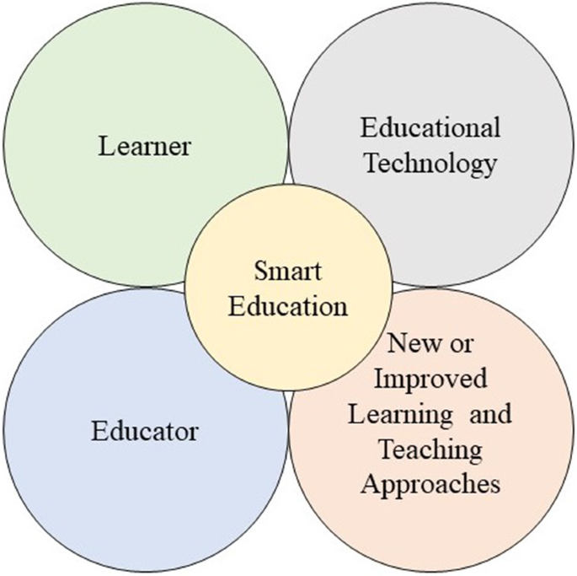
Project Objectives
The AIM of the software is to create chain of smart education among the education system and students no student should miss the opportunity they deserve in the lots of notifications and messages it becomes hectic to find appropriate and suitable thing according to user interest .
So our software overcomes this drawback of education system digitally with the help of technologies and user data we will help them out to find right opportunity and relevant information regarding activities.

Slide 9
Scope
The scope of this software depends on the number of users. This is a software which we can develop for small organization as well as big organization mostly this will beneficial for private institutions and colleges to aware their students about activities.
On the other hand it will be beneficial for big organizations like college having multiple branch and organizing contest for all.
It will also benefit to the government schemes as they want to spread their programs all among country but due to resource they cant reach to everyone but this kind of software will help to reach maximum and benefit maximum.

Slide 10
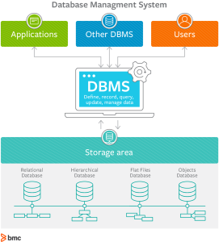
Solution Proposed
This project will mainly work on data collected of an individual .
Institution will upload the upcoming activity on the dashboard of website and then user can access and register to the activity. This is the general way to reach student but we can reach student dynamically by collection their data like –
email id
area of interest
if multiple are of interest then user will receive notification according to priority .

Slide 11
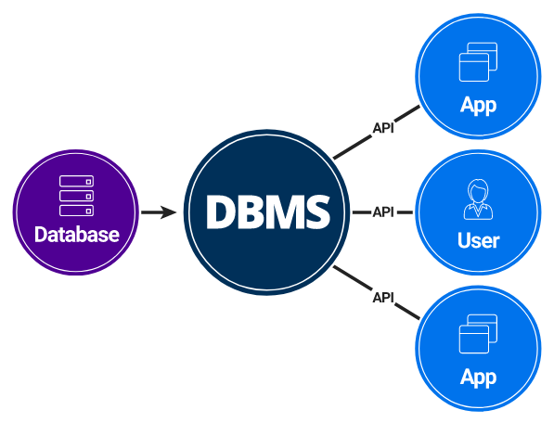
Solution Proposed
We will collect all the information of user at the time of registration all the areas of interest and ways to contact user no of interest according to priority and when institution will upload any activity or contests if the terms and tech is according to user specification system will directly forward notification to the user else it will also be open for all the user to visit statically we can also send it to all but then there will no difference in existing system and new system.

Slide 12
Methodology
Hardware & Software Requirement - Windows computer or Linux, installed with ide to work on the web development features.
Data Collection – to collect data from the student and to collect data of activities and organizations which often organize competitions.
Collection of information in Database – the set of data collected from different user will store in data base and we will extract it when needed.
Use of data structure – to provide right activity to + mostly the sorting and priority queue will use to differentiate the specification of user.
If the user specification given by user will match to the activity then notification will be sent to the user

Slide 13
The Outcome Discussion
On the completion of project it will overcome the drawback existence system and provide more accuracy to the user this software help to reach all the information to the users who are interested in that activity the software will work dynamically for long time we can adjust the no of students according to need this will be much beneficial than existing system of informing student .Also this will reduce human effort and make specific everything we can also use software for other purposes too to give information about other events and exam related news to the students .

Slide 14
Resources and Limitation
Hardware & Software Requirement –
Windows computer
CMOS sensor (Webcam)
Windows Operating installed with working ide for web development .
The requirement of the resources for designing and developing are as follows -
HTML5
CSS3
Javascript
My SQL
Node JS , Other backend technologies .

Slide 15
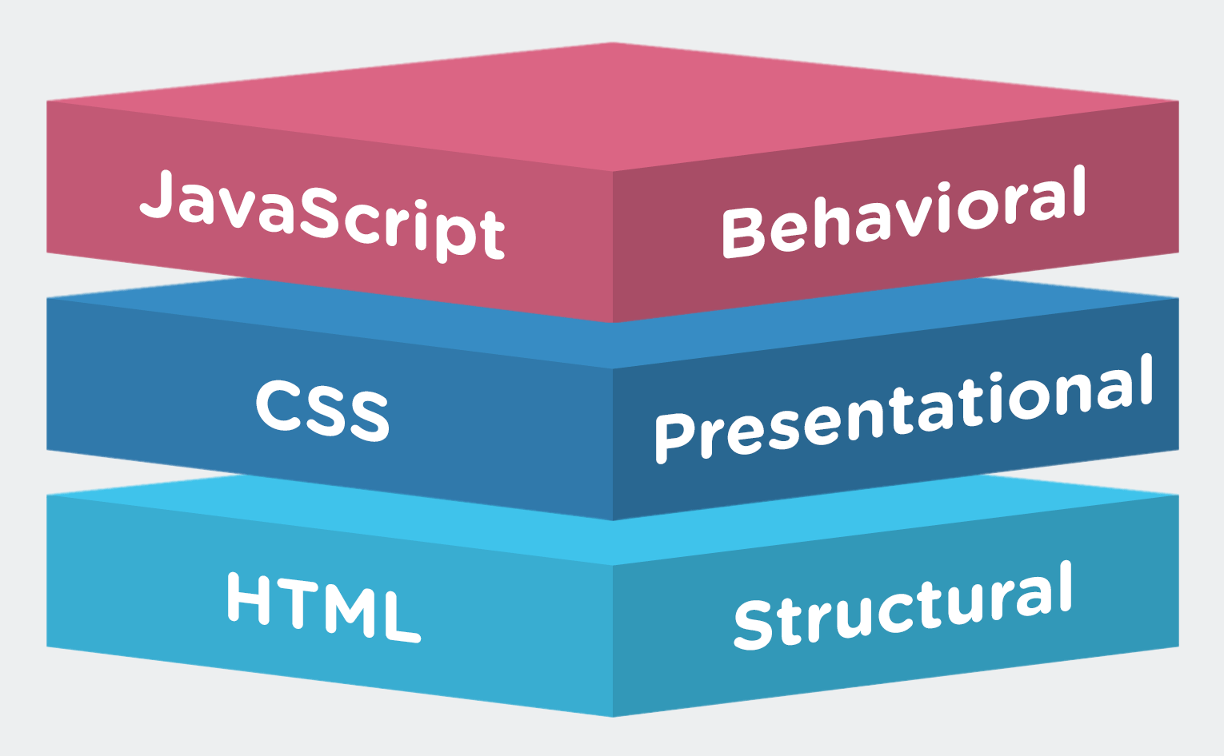
Resources and Limitation
HTML5 - HTML stands for Hyper Text Markup Language. It is the standard markup language for creating web pages. It describes the structure of a web page.
CSS3 - CSS stands for Cascading Style Sheets . It can control the layout of multiple web pages all at once, and saves a lot of work.
Javascript - Javascript is a scripting languages, primarily used on the Web. JavaScript is an interpreted language. Thus, it doesn't need to be compiled.
My SQL - MySQL is one of the most popular open-source MySQL is easy to use, reliable, and fast. A DB management system that works on embedded systems as well as client-server systems.

Slide 16
Conclusion
THE aim of this project is to reduce the miss ration in the institutions and to provide all the informations regarding activities to all the students using front end and backend technologies by collection of user data choices and preferences this software will encourage and keep focus for the topic of interest only .

Slide 17
Acknowledgment
We would like to extend sincere thanks to our Computer science and engineering department to providing such a great opportunity to work on this project . We would also like to express our sincere gratitude to prof. Priynaka jangde for her valuable guidance throughout of this project .

Slide 18
Q&A

Slide 19
THANKS

